Slide 1

Political Ads and Social Media Response
Jason Becker, Nalini Chandhi, Brian Schneider

Slide 2
The Big Question
Does TV advertising impact social media response about elections?
Should political candidates continue to buy ad spots?
Are some ads more effective at spurring Twitter activity than others?
Notes:
Brian

Slide 3






Architecture
Batch
Political Ad Data
Twitter data
EC2 instance
Stream
S3 bucket
EBS
Notes:
Jason

Slide 4
System Scale and Considerations
Considerations:
S3 - scalable and cost effective
Hive - familiarity and easy connectivity to Tableau
Tableau - custom geographies to draw DMAs
Scale:
S3 will scale automatically, we can delete aged data to save cost
Can add more EC2 nodes to the cluster to handle large data volumes
Notes:
Nalini

Slide 5
Challenges
Twitter stream data volume
Parsing nested JSON format of tweets
Tweet location data mapping to DMA (Designated Market Area)
Time attribution of tweets to political Ads
Notes:
Nalini

Slide 6
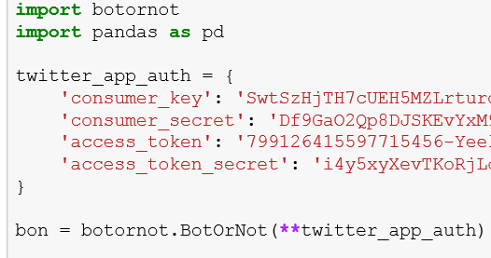
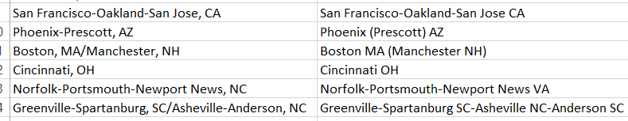
Special Tech
DMA name matching - difflib.SequenceMatcher
Sentiment Analysis - TextBlob:sentence.sentiment.polarity
Bot Detection - BotOrNot by Truthy
Tableau polygons for DMAs
Notes:
DMA – Jason
Sentiment Analysis – Nalini
Bots - Brian

Slide 7
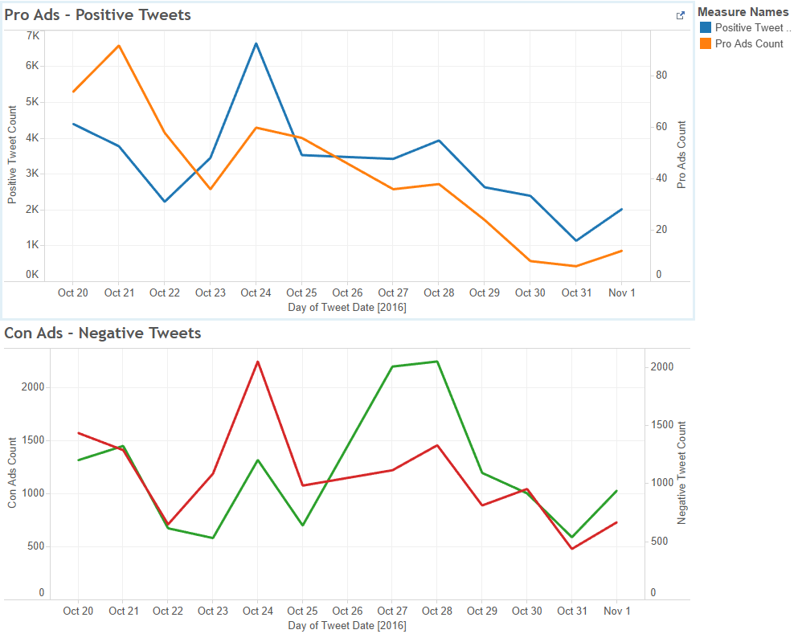
Data Analysis – Ads and Sentiment
Notes:
Nalini

Slide 8
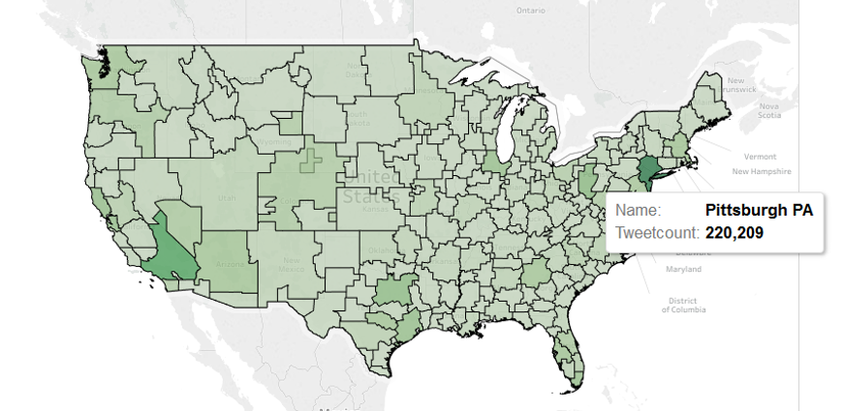
Data Analysis – Markets and Tweets
Notes:
Jason

Slide 9
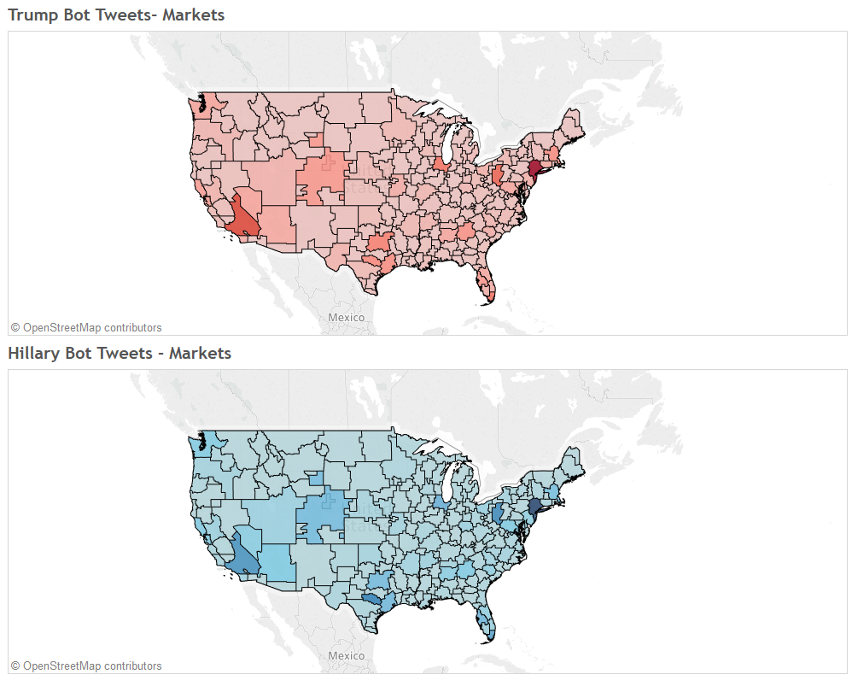
Data Analysis – Candidates and Bots
Notes:
Jason

Slide 10
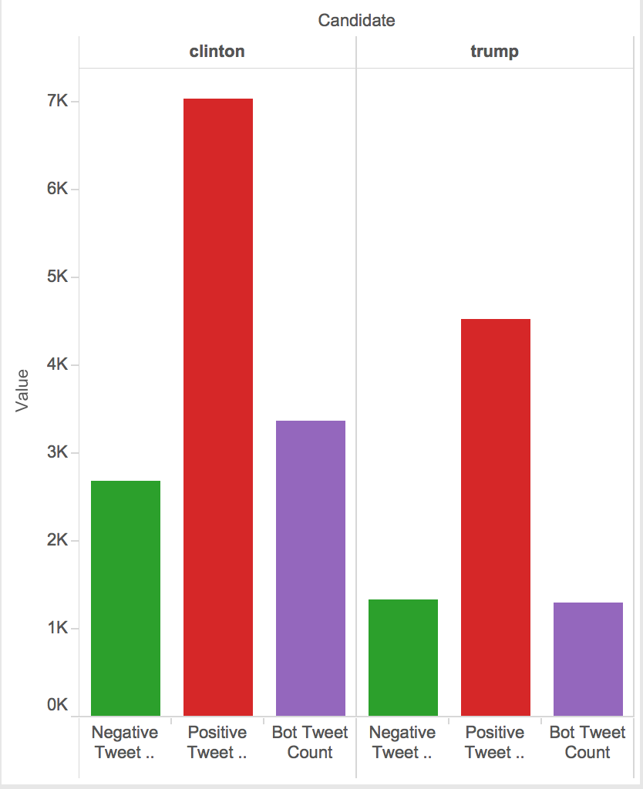
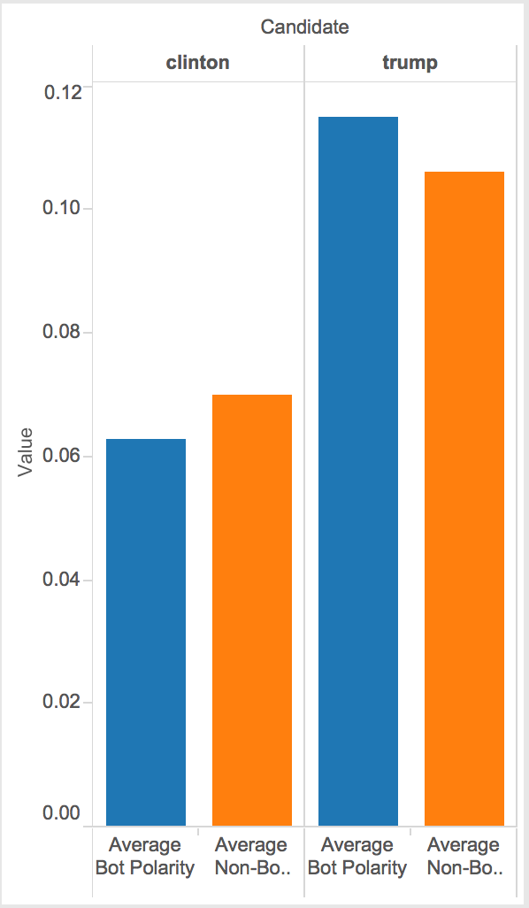
Data Analysis – Bot Bias
Clinton mentioned heavily by bots -- negatively
Notes:
Brian

Slide 11
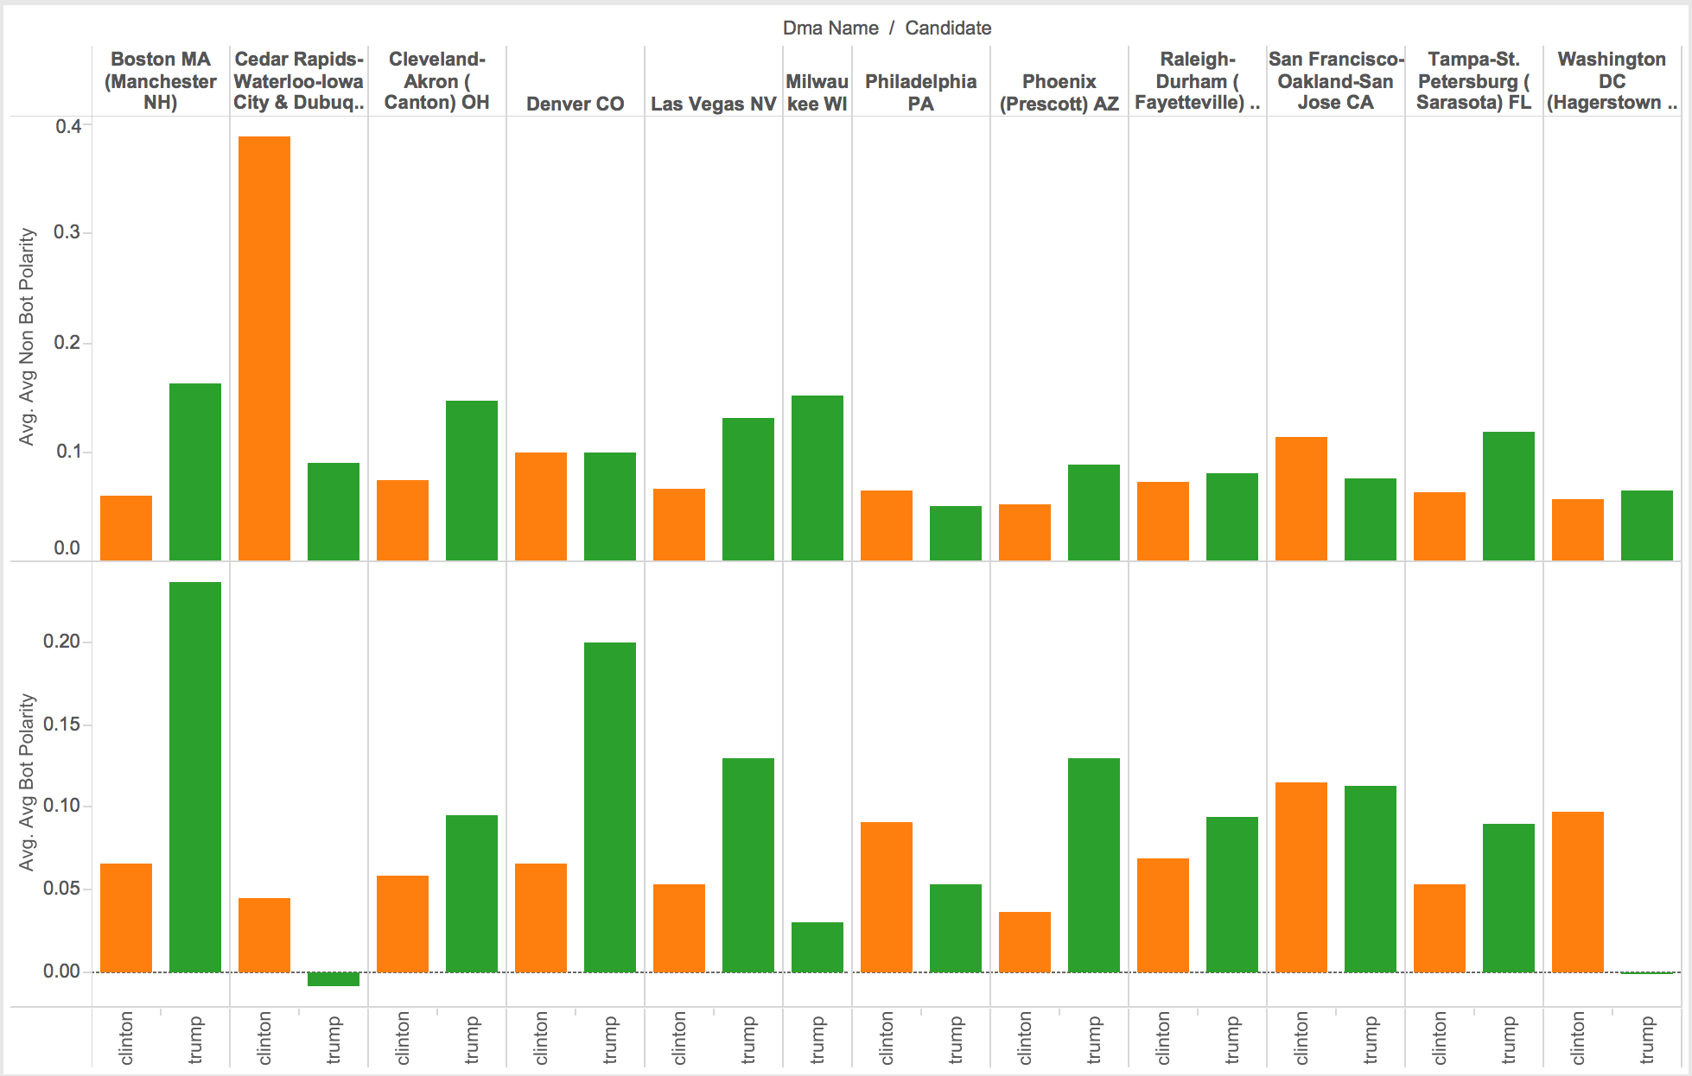
Data Analysis – Bot vs Non-Bot
Bot vs Non-Bot sentiment Polarity
Notes:
Brian

Slide 12
Next Steps
Collect other social media data like Facebook, blogs
Customize the solution for other elections
Improved Bot Detection
Refined Sentiment Analysis
Notes:
Nalini

